Slide 1

Department of Computer Science Engineering RAJASTHAN TECHNICAL UNIVERSITY, KOTA
Crime Rate Analysis and Hotspot Prediction
PRESENTED TO:
Project Coordinator
Dr. C.P. Gupta (Professor)
Supervisor
Mr. Dhirendra Singh
8 CSE
PRESENTED BY:
Diya Soni (19EUCCS018)
Jiya Verma (19EUCCS029)

Slide 2
Introduction
Crime always had an adverse effect on our society and daily lives
But due to lack of technology and unstructured data it was impossible to predict and analyze Crime pattern
Now with the advancement in technology and with the help of analyzing algorithms it has now become feasible to analyze the crime pattern and predict the crime.
Crime analysis and prediction is a systematic approach for identifying and analyzing patterns and trends in crime

Slide 3
Objective
The objective of our work is to
Predicting crime before it take place
Predicting hotspot of crime
Understanding crime pattern
Classify crime based on location
Analysis of crime
GOAL
Understanding patterns of criminal behaviour that could help in solving criminal investigations
Predicting surges and hotspot of crimes

Slide 4
Hardware and Software requirement
Minimum Hardware Requirement:
Intel(R)core(TM) i3-3200.
2GB of RAM memory.
1GB of secondary storage.
Intel UHD graphics 620.
Minimum Software Requirement:
Operating system 7 or higher, Linux.
Development Language: Python.
Interpreter: Python IDLE(3.7), Jupyter Notebook

Slide 5
Methodology
This project is implemented through machine learning, using python language in Jupyter notebook.
A model is build which uses latitude, longitude, Timestamp of crime as feature vector.
This generates crime pattern analysis and predict the most probable crime.
The dataset used here is extracted from kaggle website, which is first processed and converted into suitable format for our model.
Various algorithms were applied in the machine and was trained against training dataset.

Slide 6
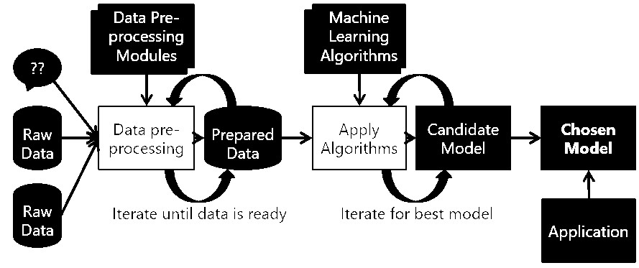
Results of the accuracy of prediction was generated using testing data set.
Algorithms used are : KNN, SVM, Decision Tree, Random Forest.
Fig 1-Flow chart

Slide 7
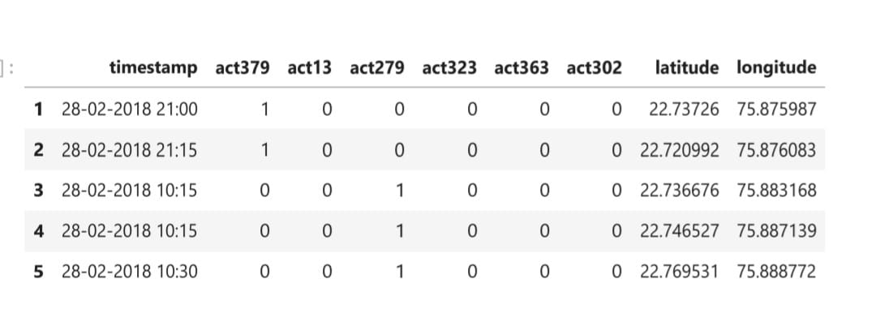
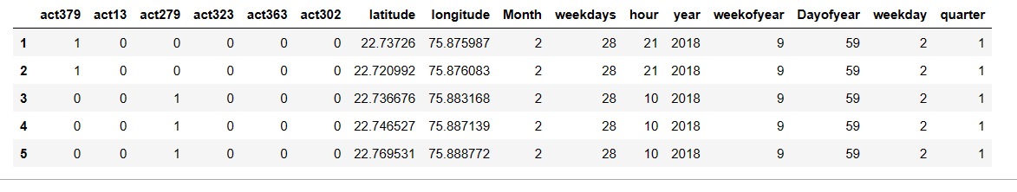
Fig 2-Original dataset
Fig 3-Data after processing

Slide 8
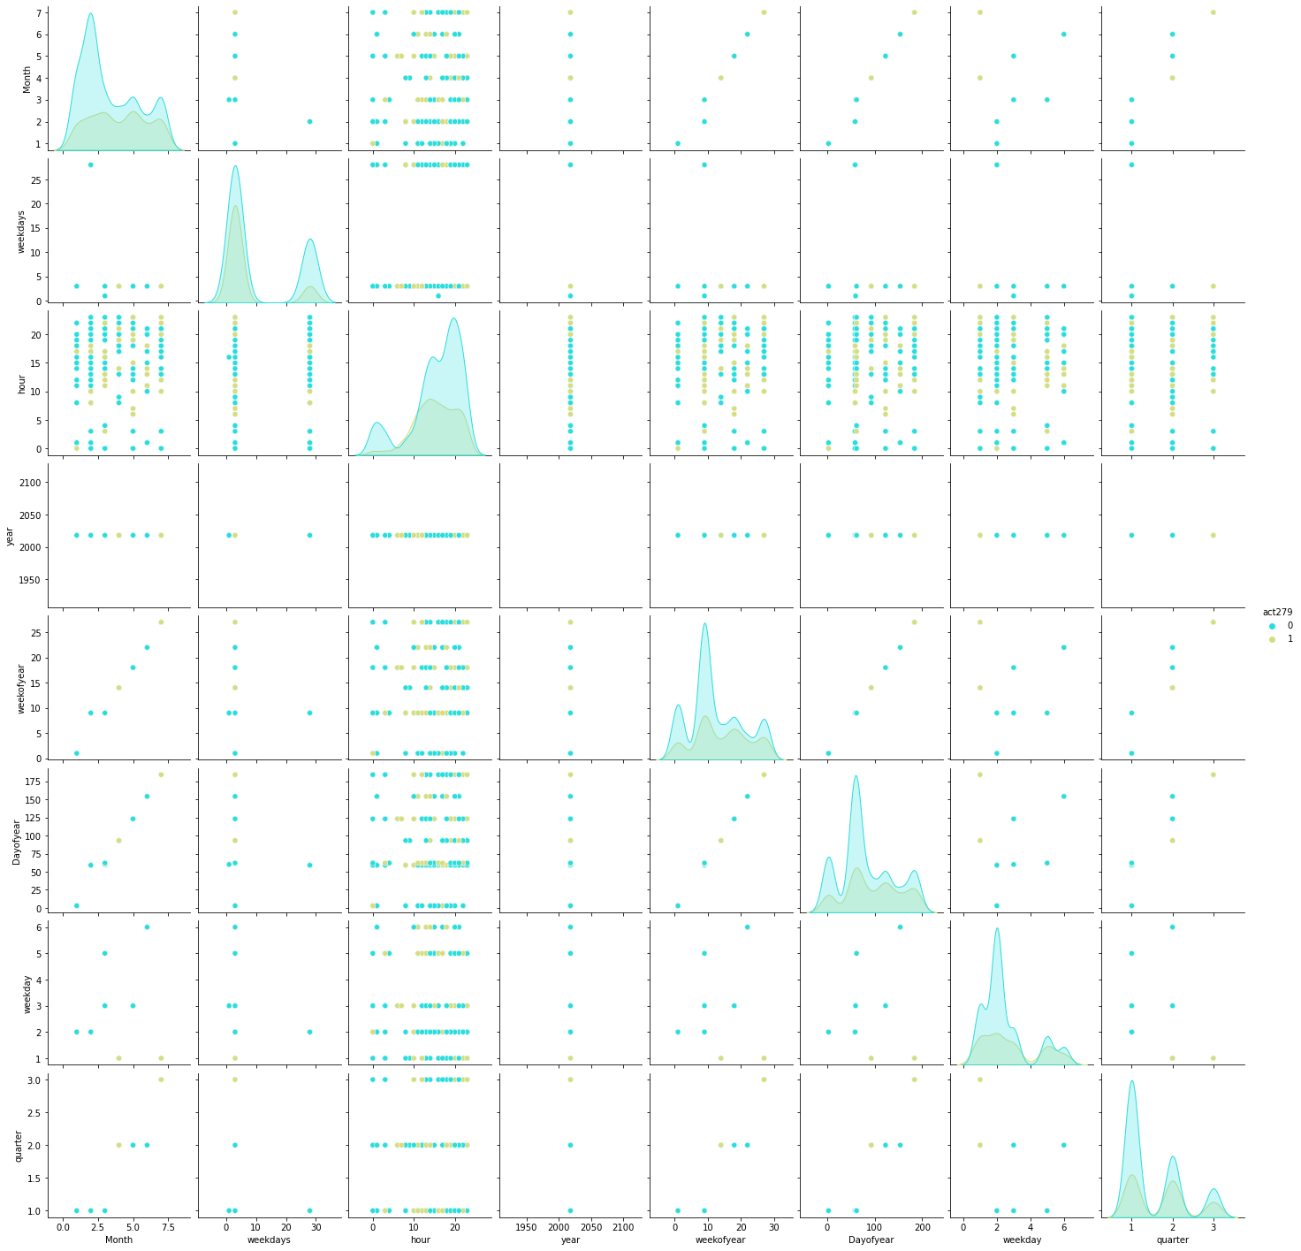
Fig 4-Pair Plot

Slide 9
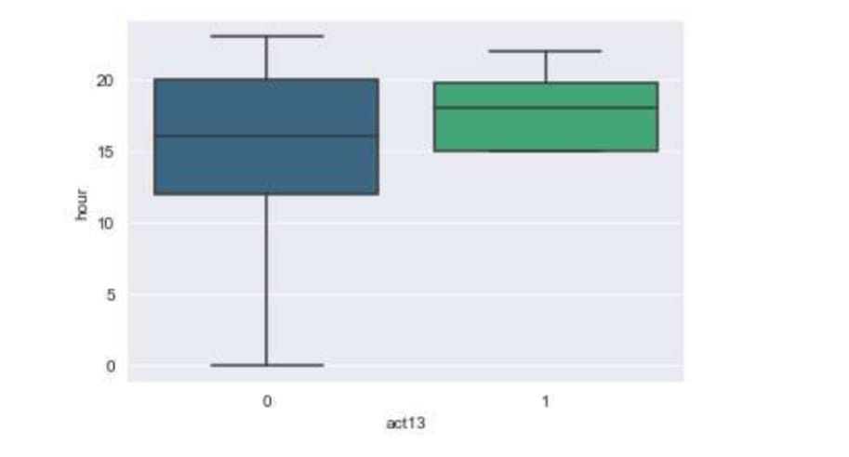
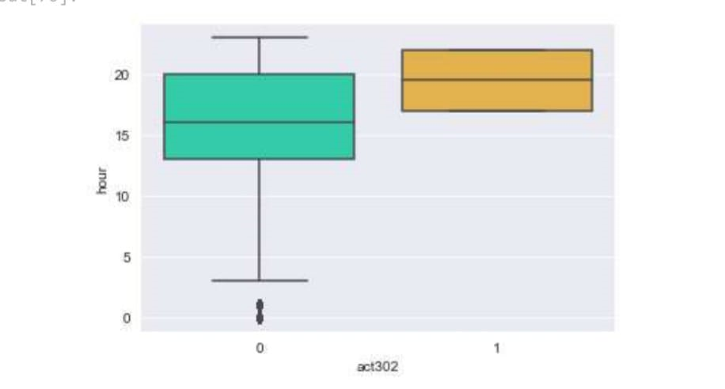
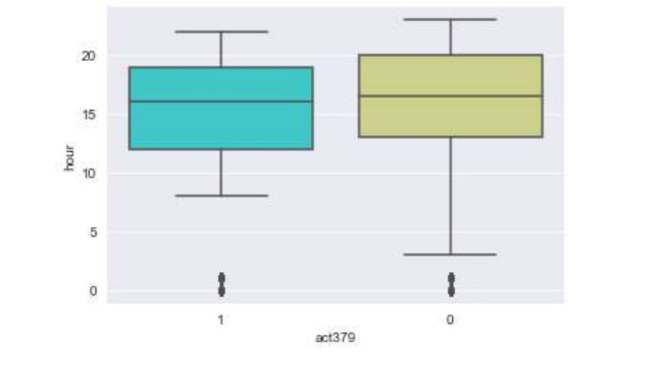
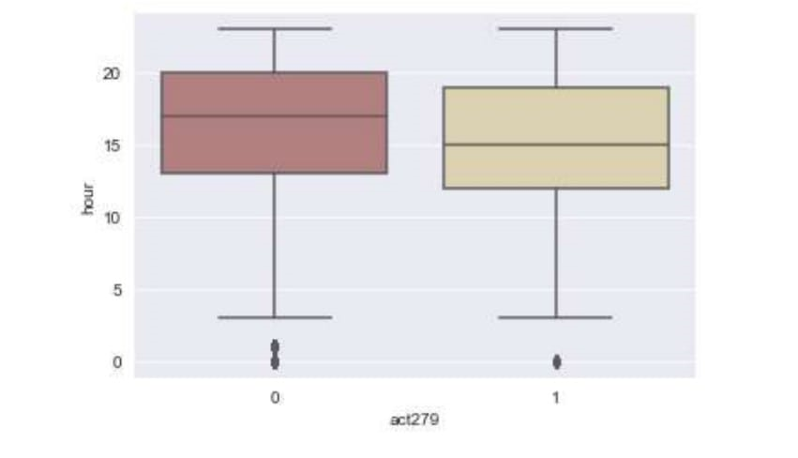
Fig 5-Crime analysis Plot of gambling
Fig 6-Crime analysis Plot of murder
Fig 7-Crime analysis Plot of Accident
Fig 8-Crime analysis Plot of theft

Slide 10
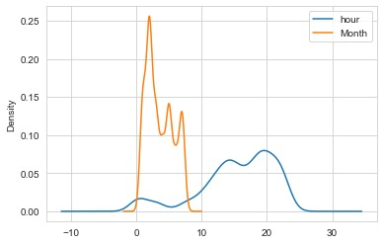
Kernel Density Estimation (KDE):
KDE was used to estimate the intensity of crime occurrences across the geographical area, visualizing areas with higher crime rates as density peaks.
Fig 9 – KDE Plot
It represents the visualization of the temporal patterns of crime incidents in terms of monthly and hourly variations

Slide 11
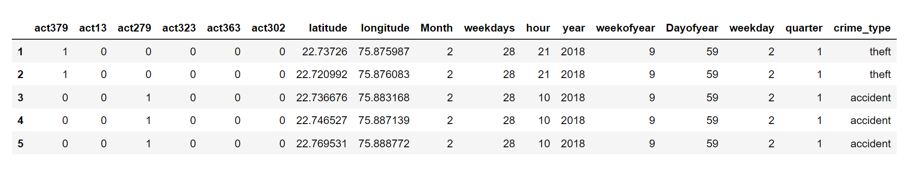
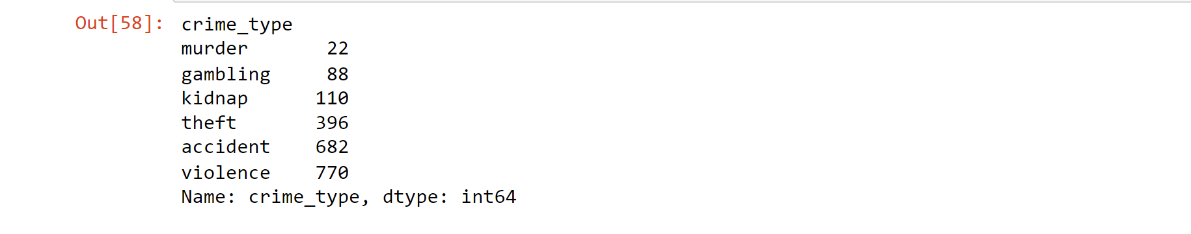
Categorizing the crime data into single column “crime_type”
By categorizing the different types of crimes into a single column, we can easily map and visualize the crime incidents on a map, making it more intuitive to identify spatial patterns, hotspots, and trends associated with specific crime types.
Frequency of Crime Type

Slide 12
In the field of crime prediction, various machine learning models can be utilized to analyze and predict crime patterns. Four commonly used models are K-Nearest Neighbors (KNN), Support Vector Machines (SVM), Decision Trees, and Random Forests
K-Nearest Neighbors (KNN):
KNN is chosen because it considers spatial proximity, which is important in crime analysis where location plays a crucial role.
It is a simple and intuitive algorithm that can handle both classification and regression tasks.
KNN can capture local patterns and outliers effectively.
Support Vector Machines (SVM):
SVM is selected for its ability to handle non-linear relationships and complex decision boundaries.
It works well when there is a need to find the best separation hyperplane in high-dimensional feature spaces.
SVM is known for its effectiveness in handling both classification and regression problems.

Slide 13
Decision Trees:
Decision Trees are chosen for their interpretability and ability to capture non-linear relationships.
They are useful when the focus is on understanding the decision-making process and extracting insights from the model.
Decision Trees can handle both numerical and categorical features, making them versatile for crime prediction tasks.
Random Forests:
Random Forests are an ensemble method that combines multiple Decision Trees, which helps to improve prediction accuracy and reduce overfitting.
They are robust models that can handle high-dimensional data and noisy features.
Random Forests provide feature importance ranking, which can be valuable in identifying the most influential factors in crime prediction.

Slide 14
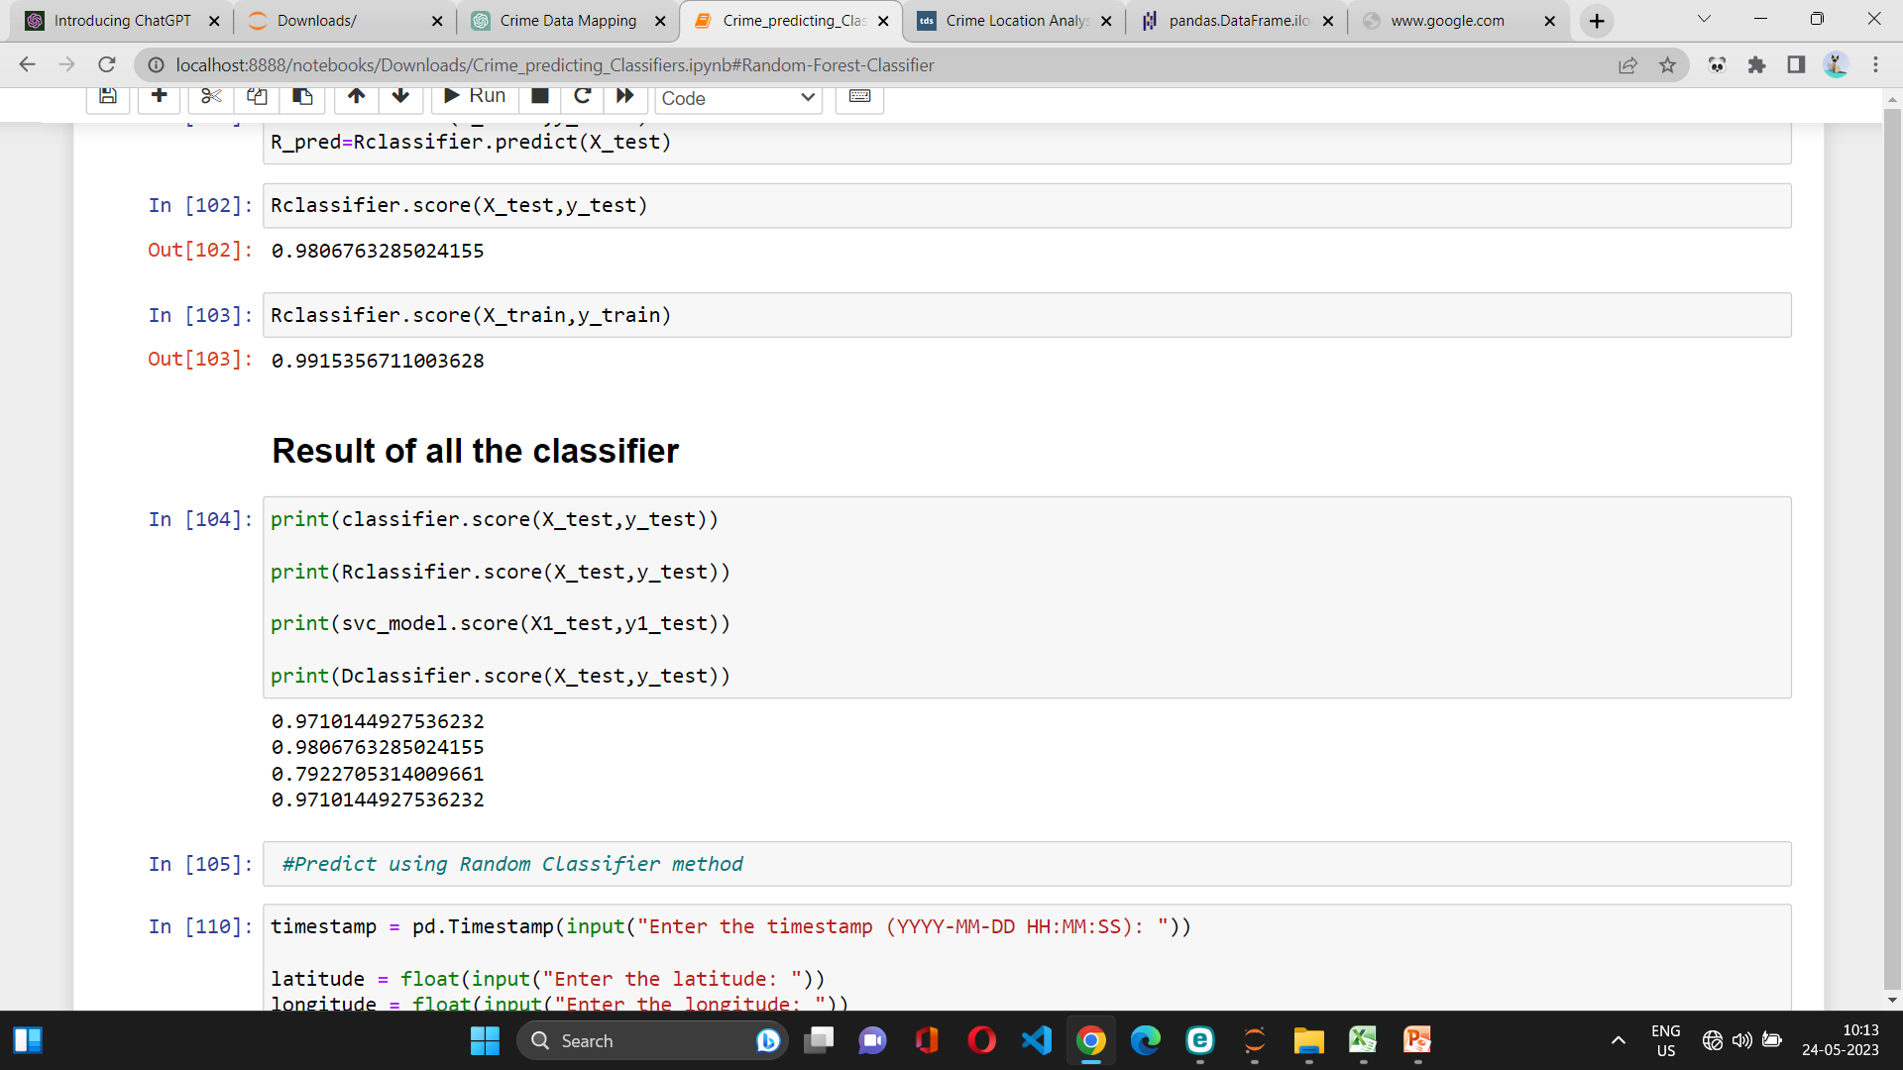
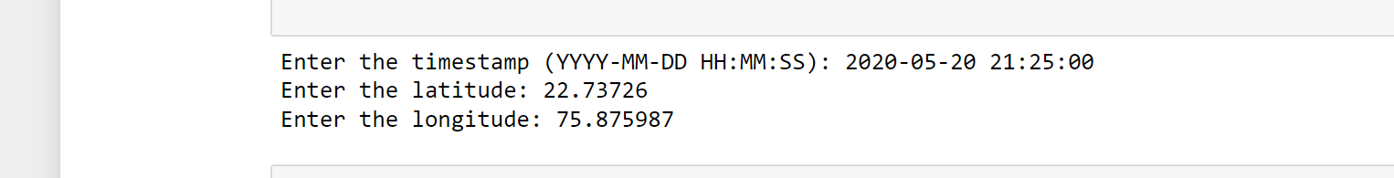
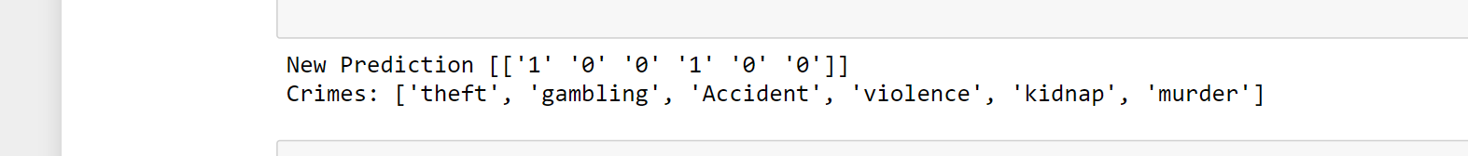
Using Random Forest Classifier Model

Slide 15
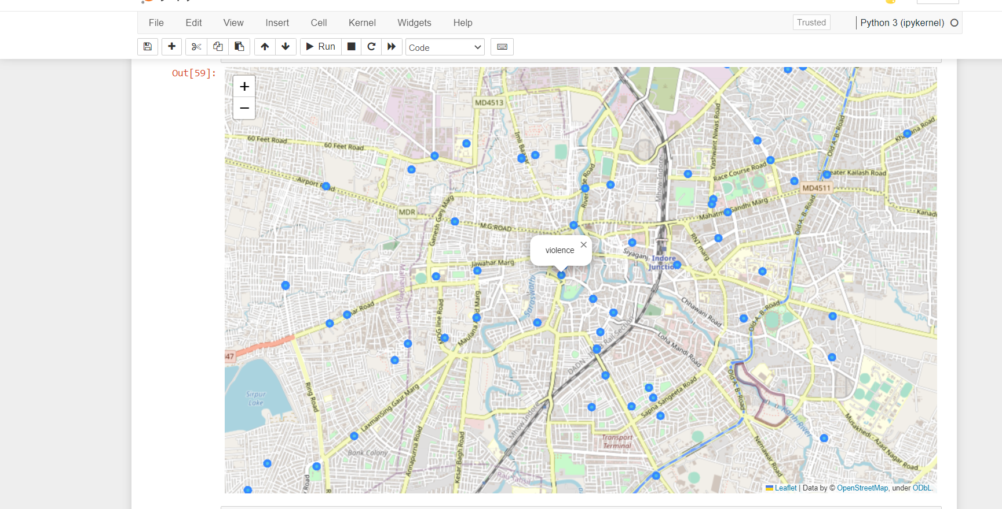
Visualize the data on maps using Folium. Here we plots points on Open Street Map with indicators for the type of event that occurred.

Slide 16
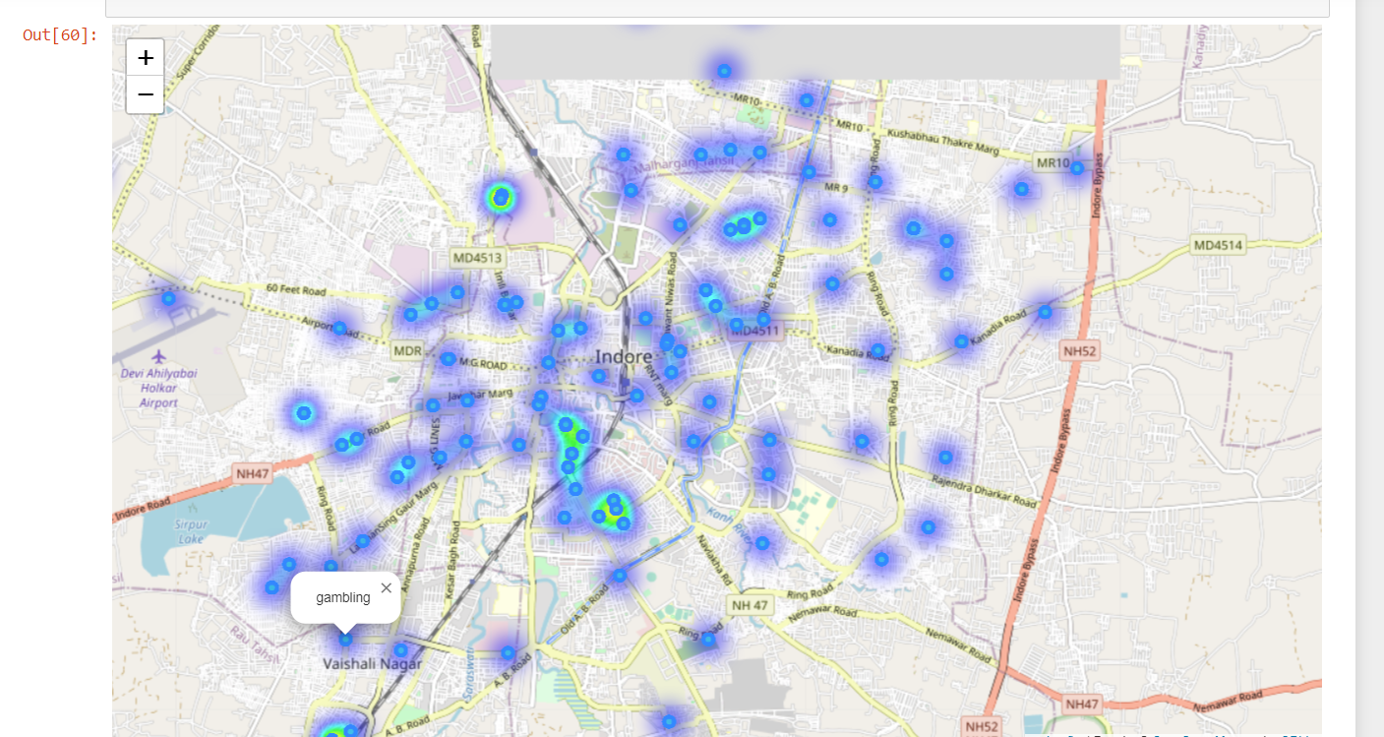
While these indicators are useful and we can zoom in on the map to see them in detail, an additional heat map would improve the visibility of high-frequency areas where multiple indicators may overlap.

Slide 17
APPLICATION
Public safety and protection related to crime and better understanding of crime is beneficial in multiple ways.
It can lead to targeted and sensitive practices by law enforcement authorities to mitigate crime
And more concerted efforts by citizens and authorities to create healthy neighborhood Environment
Understanding patterns in crime from data is an active and growing field of research.

Slide 18
References
www.ieeexplore.ieee.org/abstract/document/6906719
www.Kaggle.com
Computational Statistics and Data Analysis by Friedman Jerome.
en.wikipedia.org/wiki/Crime_analysis.
Friedman, Jerome H. ”Stochastic gradient boosting.” Computational Statistics and Data
LeoBreiman, Random Forests, Machine Learning, 2001,Volume 45, Number 1, Page 5
Wang, Tong and Rudin, Cynthia and Wagner, Daniel and Sevieri, Rich. 2013. pages 515-530, Machine Learning and Knowledge Discovery in Databases

